Slide 1

ONLINE FOOD ORDERING AND DELIVERY SYSTEM
FoodieExpress
From menu discovery to delivery confirmation.
Presented By: Arun Prasath K
Registration No: 241001018
Notes:
1

Slide 2



PROJECT PURPOSE
Discover
Order
Track
One place to order.
Browse nearby restaurants and food items through one online platform.
Select items, manage the cart, and confirm delivery details.
Connect restaurant processing with delivery status in one workflow.
A practical bridge between appetite, restaurants, and delivery.
Built with HTML, CSS, JavaScript, React, and PHP.
Notes:
2

Slide 3



SYSTEM FOUNDATION
The system needs a simple stack and a reliable runtime
Software
Hardware
Runtime
HTML, CSS, JavaScript, React, PHP, database, code editor, and browser.
A laptop or desktop, internet connection, and a test device for responsive checks.
Frontend interaction, PHP server-side processing, and database storage for users, menus, and orders.
A lightweight stack keeps the project understandable, testable, and ready to extend.
Notes:
3

Slide 4

Customers move from discovery to delivery in one continuous flow
Browse
Checkout
Delivery
Restaurants and food items
Details and confirmation
Status reaches completion
Cart
Processing
Quantity and selected items
Restaurant receives order
The customer sees one connected journey while the system coordinates every handoff.
Notes:
4

Slide 5

IMPLEMENTATION IDEA
REPRESENTATIVE FLOW
Sample coding shows how the frontend and backend work together
const addToCart = async (item) => {
setCart(current => [...current, item]);
await fetch("/api/orders", {
method: "POST",
headers: {"Content-Type": "application/json"},
body: JSON.stringify({itemId: item.id})
});
};
React manages reusable menu cards, cart items, and order status. JavaScript validates actions and updates the interface without unnecessary page reloads.
PHP receives the request, applies business logic, and returns menu or order data.
The interface responds immediately; the backend persists the order request.
Notes:
5

Slide 6
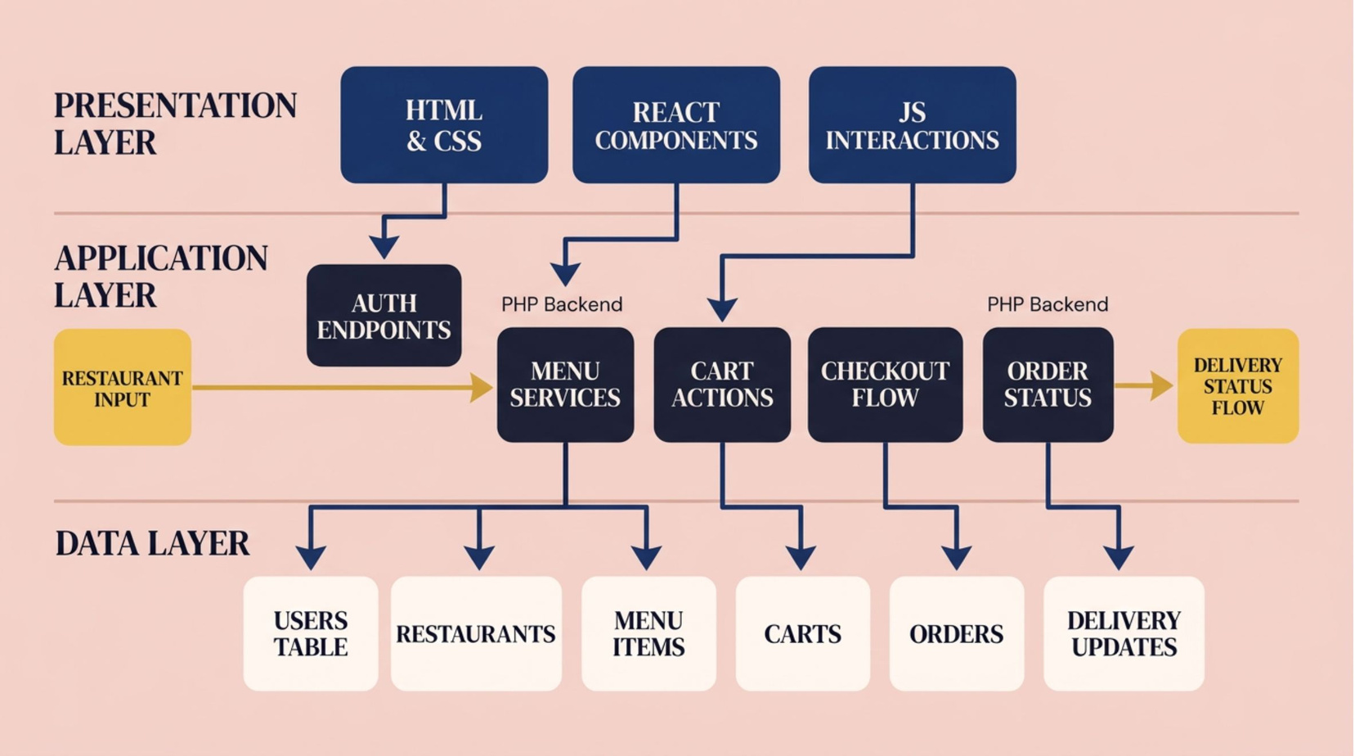
SYSTEM DESIGN
FoodieExpress uses a layered architecture
Each layer has a clear responsibility, while restaurant and delivery status flows meet in the application layer.
Notes:
6

Slide 7
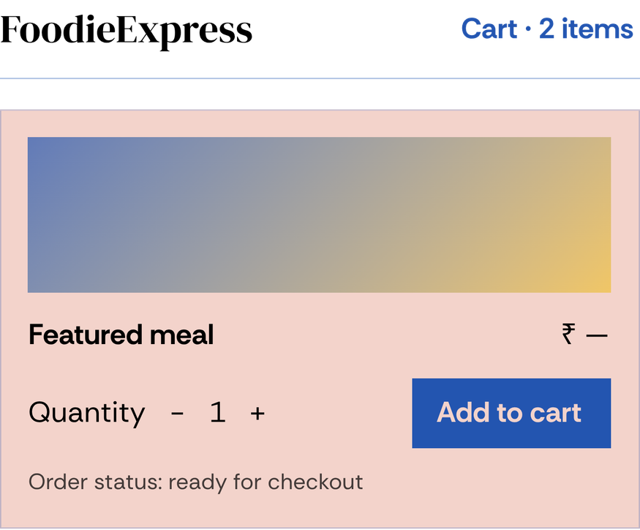
DEMO SEQUENCE
The demo proves the core ordering journey
Open the FoodieExpress home page and browse available food.
1
Select an item and show the cart updating.
2
Complete checkout with delivery information.
3
Use screenshots or live UI moments to make the flow easy to follow.
Show the order confirmation and status update from the system.
4
Notes:
7

Slide 8

PROJECT OUTLOOK
FoodieExpress
turns a common task into one connected experience.
The takeaway is simple: FoodieExpress turns menu discovery into a clear, connected path all the way to delivery confirmation. The chosen stack supports reusable interfaces, server-side processing, and structured data storage.
Future scope is focused: payments, ratings, notifications, restaurant dashboards, and live delivery tracking.
One order, carried through.
Notes:
8

